Slide 1
TEX-ABOTA SANTA FE CLE roundup June 15-18, 2023

Slide 2
2023 Legislative update 88th Regular session
Mid-term madness

Slide 3
PRESENTED BY:
David E. Chamberlain
GUY D. CHOATE
CHAMBERLAIN MCHANEY
301 CONGRESS AVE, 21ST FLOOR
AUSTIN, TEXAS 78701
512-474-9124
WEBB, STOKES & SPARKS, L.L.P.
314 W. HARRIS AVE
SAN ANGELO, TEXAS 76903
325-653-6866

Slide 4
Two critical session resources
Jerry Bullard does a terrific job of tracking legislation and has been a generous resource to interested Texans. Jerry wrote the paper for this presentation
Jerry Bullard j.bullard1@verizon.net
The State has an excellent website that allows you to track legislation in near real time:
https://capitol.texas.gov/

Slide 5
Big Issues!
COURT REDISTRICTING
What do you think about “Special Courts”?
For Special People!

Slide 6
Dan Patrick is Lt. Governor
19 GOP Members and 12 Democratic members
Blocker bill now requires 18 to bring up a bill.
Dan Patrick Changed the rules to accommodate the numbers.

Slide 7
Dade Phelan
SPEAKER OF THE HOUSE
86 Republicans
64 democrats

Slide 8
sINE Die!: Latin for “Thank God”
The regular session of the 88th Legislature came to a close. According to the Texas Legislative Reference Library, a total of 8,046 bills were introduced during the session. Of that total, 1,246 bills were passed and sent to Governor Abbott, some of which have already been signed into law or are vetoed. The Governor has until June 18, 2023 to sign, veto, or allow to become law (without signature) legislation that was passed during the regular session.

Slide 9
Smart moves by the gop majority
The Texas House unanimously voted to expel Bryan Slaton on Tuesday, one day after the Royse City Republican submitted his resignation after an internal investigation determined that he had sex with a 19-year-old aide after getting her drunk.
In a historic vote, an overwhelming majority of Texas House members voted Saturday to impeach embattled Attorney General Ken Paxton. Most Republican and Democratic members of the House voted for Paxton's impeachment, which took place after several hours of debate.

Slide 10
SB 379: TAX CODE FINALLY AMENDED
SB 379: TAX CODE FINALLY AMENDED
FEMININE HYGIENE PRODUCTS.
MATERNITY CLOTHING.
BREAST MILK PUMPING PRODUCTS.
BABY BOTTLES.

Slide 11
Business Courts: Special Courts for special People
HB 19 – Creation of a Specialty Trial Court (Business Court Judicial Divisions (Companion: SB 27)
Summary: HB 19, filed by Rep. Andrew Murr (R – Kerrville), creates a business trial court system in Texas.
There are a LOT of moving parts. Court is not created until January 1, 2025, though the effective date is September 1, 2023.

Slide 12
Fifteenth Court of Appeals
SB 1045 – Creation of the Fifteenth Court of Appeals (Companion: HB 3166; Joint Resolution: HJR 139 )
Summary: SB 1045, filed by Sen. Joan Huffman (R – Houston), establishes the Fifteenth Court of Appeals, which would be a district composed of all counties. The court will be based in Austin and composed of a chief justice and four justices. Under SB 1045, the court has exclusive immediate appellate jurisdiction over: (1) matters brought by or against the state or a board, commission, department or executive state agency, or by or against an officer or employee thereof arising out of the officer’s or employee’s official conduct; (2) matters in which a party to the proceeding challenges the constitutionality or validity of a state statute or rule and the attorney general is a party; and (3) any other matter as provided by law.

Slide 13
Arbitration: Nibbling round the edges
HB 1255 – Limitation Periods in Arbitration Proceedings
Summary: HB 1255, filed by Rep. John Smithee (R – Amarillo), amends Chapter 16 of the Civil Practice and Remedies Code (CPRC) by adding section 16.073, which provides that “a party may not assert a claim in an arbitration proceeding if the party could not bring suit for the claim in court due to the expiration of the applicable limitations period.” However, under the proposed section 16.073, the party “may assert a claim in an arbitration proceeding after expiration of the applicable limitations period if: (1) the party brought suit for the claim in court before the expiration of the applicable limitations period; and (2) a court ordered the parties to arbitrate the claim."
Effective date: May 24, 2023.

Slide 14
Construction defects
HB 2022 – Residential Construction Liability (Companion Bill: SB 873)
Summary: HB 2022, as originally filed by Rep. Jeff Leach (R – Allen), amends Chapter 27 of the Property Code and provides that:
A contractor is liable only to the extent a defective condition proximately causes actual physical damage to the residence, an actual failure or lack of capability of a building component to perform its intended function or purpose, or a verifiable danger to the safety of the occupants of the residence.
A contractor is not liable for damages caused by the failure of a person other than the contractor to timely notify the contractor of a construction defect.
A contractor is not liable for normal cracking or shrinkage cracking.
(Cont. on next slide)

Slide 15
Construction defects (Cont.)
HB 2022 – Residential Construction Liability (Companion Bill: SB 873)
To maintain a breach of a warranty of habitability, a claimant must establish that a construction defect was latent on the date the residence was completed or title was conveyed to the original purchaser and the defect has rendered the residence uninhabitable for its intended use as a home.
A contractor must have up to three inspections during the 35-day right to cure period.
Recoverable damages will be limited only to economic damages as listed in the statute.
The court or arbitration tribunal may find that an offer of settlement by the contractor made after the applicable deadline is timely if the claimant failed to provide the contractor with evidence of the defect, or amended a claim to add a new alleged defect (or under circumstances beyond the contractor’s control).
Limitations applies to an arbitration proceeding as it does to a filing in court.
HB 2022 also repeals § 27.004(l), § 27.0042(b), and § 27.007(c).
Effective date: September 1, 2023.

Slide 16
Healthcare liability
SB 2171 – Qualification of Experts in Certain Healthcare Liability Claims (Companion: HB 1791)
Summary: SB 2171, filed by Sen. Carol Alvarado (D – Houston), would amend the CPRC to provide that, in suits involving a health care liability claim against a chiropractor, a person may qualify as an expert witness on the issue of the causal relationship between an alleged departure from accepted standards of care and the injury, harm, or damages claimed if the person is a chiropractor or physician and is otherwise qualified to render opinions on that causal relationship under the Texas Rules of Evidence.
Effective date: September 1, 2023

Slide 17
Judiciary privacy
SB 372 – Creating a Criminal Offense for the Unauthorized Disclosure of Judicial Opinions (Companion: HB 1741)
Summary: SB 372, filed by Sen. Joan Huffman (R – Houston), amends the Government Code to make it a Class A misdemeanor for a person, other than a justice or judge, with access to non-public judicial work product to knowingly disclose the contents of any non-public judicial work product to a person who is not a justice, judge, court staff attorney, court clerk, law clerk, employee of an agency established under Chapter 71 (Judicial Council) or 72 (Office of Court Administration) of the Government Code, or other court staff routinely involved in crafting an opinion or decision for an adjudicatory proceeding. However, it will be a defense to prosecution if the disclosure was authorized either in writing by the justice or judge for whom the work product is prepared or under Texas Supreme Court rules.
Effective date: September 1, 2023.

Slide 18
Interlocutory appeals
SB 1603 – Relating to the Decision of a Court of Appeals Not to Accept Permissive Interlocutory Appeals (Companion: HB 1561)
Summary: SB 1603, as originally filed by Sen. Bryan Hughes (R – Mineola), amends section 51.014 of the CPRC and require a court of appeals to specify its reasons for finding that a permissive appeal is not warranted under 51.014(d) if the court does not accept the appeal. SB 1603 also provides that the Supreme Court may review a decision by a court of appeals not to accept a permissive appeal under an abuse of discretion standard. The House floor amendments did the following: (1) changed the Supreme Court’s standard of review from an abuse of discretion to de novo, and (2) provides that the court of appeals could be directed to accept the appeal if the Supreme Court determined that the requisites for a permissive appeal have been satisfied.
Effective date: September 1, 2023. The change in law made by SB 1603 would apply only to an application for a permissive appeal filed on or after the effective date.

Slide 19
Supreme court rule making authority
Summary: SB 2275, filed by Sen. Bryan Hughes (R – Mineola), repeals section 22.004(c) of the Government Code, which states as follows:
“So that the supreme court has full rulemaking power in civil actions, a rule adopted by the supreme court repeals all conflicting laws and parts of laws governing practice and procedure in civil actions, but substantive law is not repealed. At the time the supreme court files a rule, the court shall file with the secretary of state a list of each article or section of general law or each part of an article or section of general law that is repealed or modified in any way. The list has the same weight and effect as a decision of the court.”
Effective date: September 1, 2023.

Slide 20
Judicial conduct Commission
HB 367 – Powers and Duties of the State Commission on Judicial Conduct
Summary: HB 367, filed by Rep. Jacey Jetton (R – Sugar Land), amends the Government Code to authorize the State Commission on Judicial Conduct (SCJC) to accept complaints, conduct investigations, and take any other action authorized by statute or the Texas Constitution, with respect to a candidate for judicial office who is subject to the Judicial Campaign Fairness Act, in the same manner SCJC is authorized to take those actions with respect to a judge.
In 2019, the 87th Legislature passed—and Texas voters subsequently approved—a constitutional amendment that provides the constitutional authority for the SCJC to enforce the Code of Judicial Conduct and administer discipline with respect to judicial candidates.
Effective date: September 1, 2023.

Slide 21
Attorneys and grievances
HB 5010 – Classification of a Grievance Filed with the State Bar of Texas (Companion: SB 2462)
Summary: HB 5010, filed by Rep. Mike Schofield (R – Katy), amends section 81.073 of the Government Code and require the chief disciplinary counsel’s office to classify complaints based on whether the complaint is submitted by a person who has a cognizable individual interest in or connection to the legal matter or facts alleged in the grievance. HB 5010 also allows an attorney against whom the complaint is filed to appeal the classification of the grievance.
Effective date: September 1, 2023.

Slide 22
Lazy Judges billS
HB 841 – Gathering and Maintenance of Certain Judicial Statistics by the Texas Judicial Council
Summary: HB 841, filed by Rep. Claudia Ordaz (D – El Paso), requires the Texas Judicial Council to gather and maintain more detailed statistics about case-level information related to the amount and character of the business transacted by courts.
Effective date: September 1, 2023.
HB 3474 –Judges will be monitored by OCA with precise (but misleading) case clearance stats. Senator Huffman amendment.

Slide 23
Court Qualifications
HB 2384 – Court Administration/Knowledge, Efficiency, Training, and Transparency Requirements for Judicial Office Holders and Candidates
Summary: HB 2384, filed by Rep. Jeff Leach (R – Allen), amends applicable sections of the Election Code and Government Code to do the following: It is a long list.

Slide 24
Ride share company liability
SECTION A1.AATitle 6, Civil Practice and Remedies Code, is amended by adding Chapter 150E to read as follows: CHAPTER 150E. CIVIL ACTIONS OR ARBITRATIONS INVOLVING TRANSPORTATION NETWORK COMPANIES:
https://capitol.texas.gov/Search/DocViewer.aspx?ID=88RHB017453A&QueryText=%22HB+1745%22&DocType=A

Slide 25
Texas citizens participation Act
HB 527 – Persons Exercising Certain Constitutional Rights for Purposes of a Motion to Dismiss under the TCPA
Summary: HB 527, filed by Rep. Gene Wu (D – Houston), amends section 27.010(a) of the CPRC and adds a new subsection (13) that expressly exempts “a legal malpractice claim brought by a client or former client” from the scope of the TCPA.
Effective date: September 1, 2023. The changes in the law addressed in HB 527 would apply to an action that commences on or after the effective date.

Slide 26
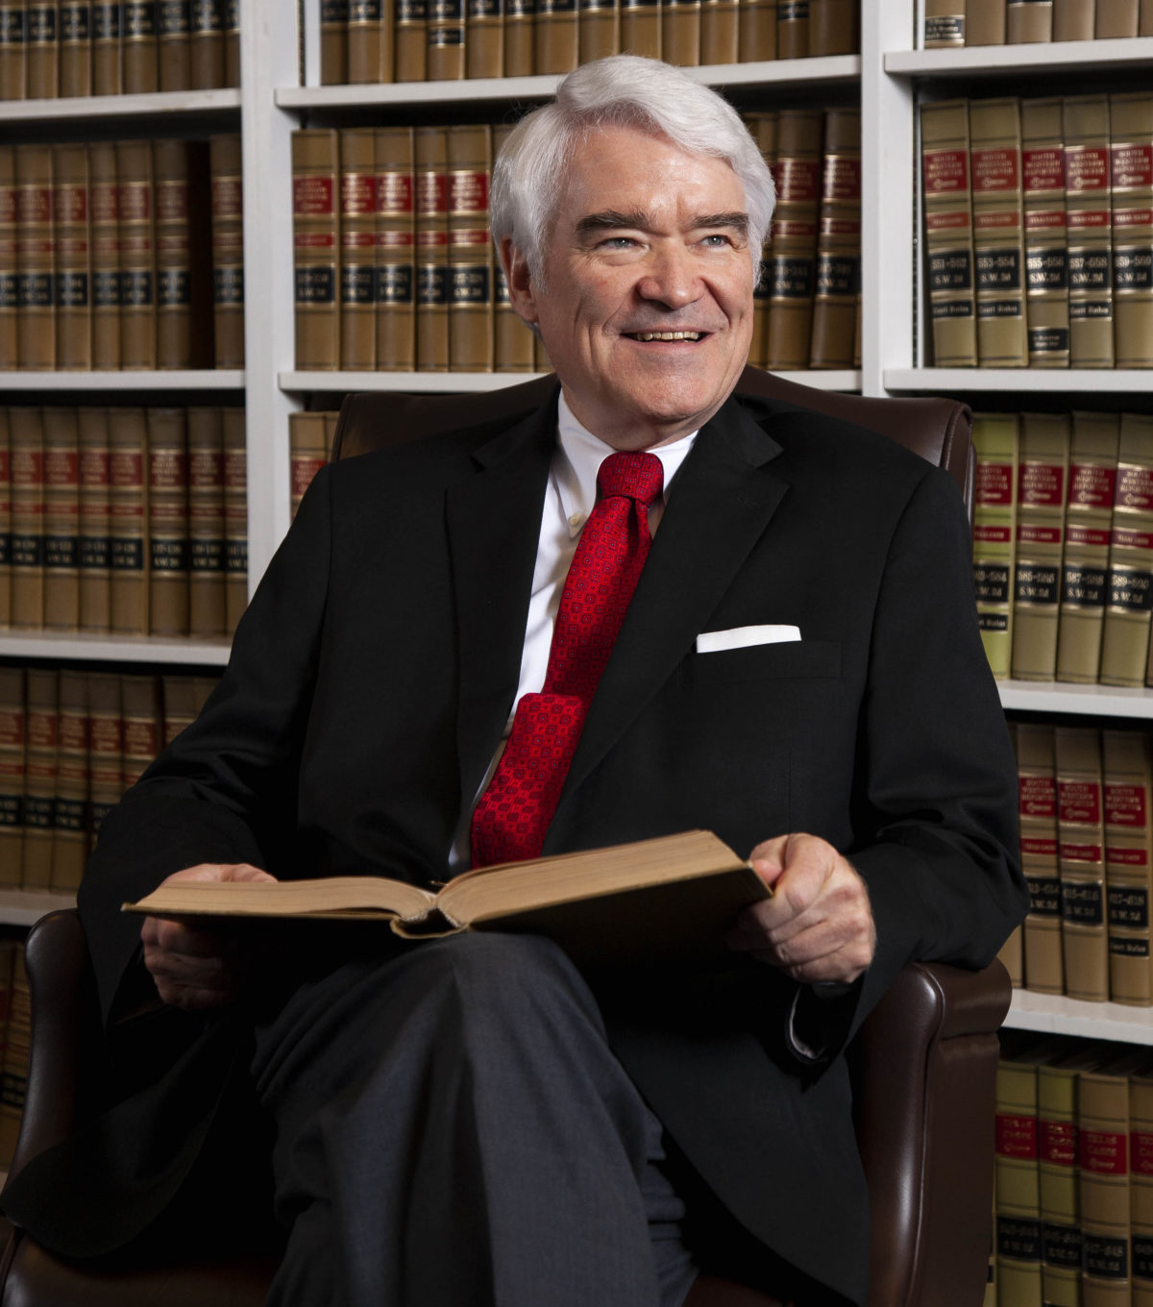
Nathan hecht act
Constitutional Amendment raising the Judicial Retirement age from 75 to 79.
Who knew I’d live this long?

Slide 27
Vehicle inspections not required
HB 3297:
Will do away with the requirement of yearly Vehicle Safety Inspections.
17 most populous counties will still require air quality inspections.
Effective Sept 1, 2023

Slide 28
Important bills that failed
HB 536 – Liability Limits in a Health Care Liability Claim
Attach the Cap to the CPI
SB 802 – Annual Base Salary of a District Judge (Similar Bill: HB 2779)
Judicial Pay Increase
HB 525 – Delivery of Court Orders Through Electronic Filing System:
Court Orders must be efiled.
HB 2014 – Reimbursement for Jury Service
** Jury Reimbursement
HB 1372 – Tort of Public Nuisance (Similar Bill: SB 1034)
Essentially abolish nuisance.
SB 575 – Creation of Cause of Action for Deprivation of Rights and Waiver of Immunity
Ameliorate qualified immunity

